Slide 1


Academic
Advising
Report
MARKETING RESEARCH
Eva Gonzalez-Bravo, Henry Hathhorn, Allisa Ward, Tori Lotz

Slide 2
Background
  MNU’s academic advising process is carried out by faculty, once a semester.
  40-50 full-time faculty members are assigned to work with ~750 students.
  Our research focuses on the traditional undergraduate academic advising experience.
  Research is based off of a presentation by Dr. Myrtle from the start of the semester.
Notes:
Advisors are assigned to students before the beginning of underclassman years based on major.

Slide 3

Objectives
Notes:
These objectives were created by our team and confirmed by Dr. Myrtle and Dr. Wallentine.
These objectives serve as our guidelines for the entire project and are the basis for our research.

Slide 4
RESEARCH OBJECTIVES
Identify strengths, weaknesses, and student satisfaction
in the current advising system.
1
2
Assess student perceptions and preferences regarding alternate advising models and practices.
3
Determine best practices for effective student
advising at other universities.

Slide 5
Methodologies

Slide 6

SECONDARY RESEARCH METHODOLOGY
Term: Secondary research involves gathering existing data rather than conducting new research.
  Internal Secondary Research refers to data collected from within the university being studied.
  External Secondary Research involves data obtained from sources outside the university being studied.
Purpose | Method | Details
To understand how other advising models compare to ours at MNU. | Various sources were utilized, including websites, articles, previous projects, and the National Academic Advising Association. These sources were accessed in February, March, and April of 2024. | A SWOT analysis was conducted. Key findings were analyzed. Multiple advising models were evaluated.

Slide 7
FOCUS GROUP METHODOLOGY
Term: A moderator-led discussion group among population of interest.
  Conducted on March 26th, 2024 from 6:30 - 8:30 PM.
    9 voluntary participants: 5 females, 4 males.
    Traditional undergraduate students.
Purpose | Method | Details
To gather students’ thoughts and opinions about the current and alternative advising models. | Invitations to the entire traditional undergraduate student body through email Initial invite and final confirmation email 2-hour discussion Dinner and gift card incentives | A wide range of ages and majors were represented Multiple advising models were evaluated. Thoughtful discussion of the pros and cons of the current advising method
Notes:
5 women, 4 men
Comp Sci,
Ministry/History,
Nursing,
Criminal Justice,
Marketing,
Kinesiology,
Physical Education,
Biology/Chemistry,
Sports Management
3 Fresh,
4 Soph,
2 Senior

Slide 8
SURVEY METHODOLOGY
Term: Standardized tool that gathers primary quantitative and qualitative data.
  Online survey sent to the entire traditional undergraduate student body through email.
    Voluntary response sampling (non-probability sampling method).
Purpose | Method | Details
To gather numerical data from a wide variety of traditional undergraduate students concerning the three objectives. | Created by the marketing team using QuestionPro 30 total questions 2 $50 gift cards as incentives | 139 completed responses Even distribution of class and department responses 18% response rate
Notes:
Non-probability means not truly random
4 demographic
4 open-ended
24 close-ended
323 viewed
180 Total Responses
139 Completed
9 min on average to complete.
(~18% response rate)
for trad undergrad

Slide 9
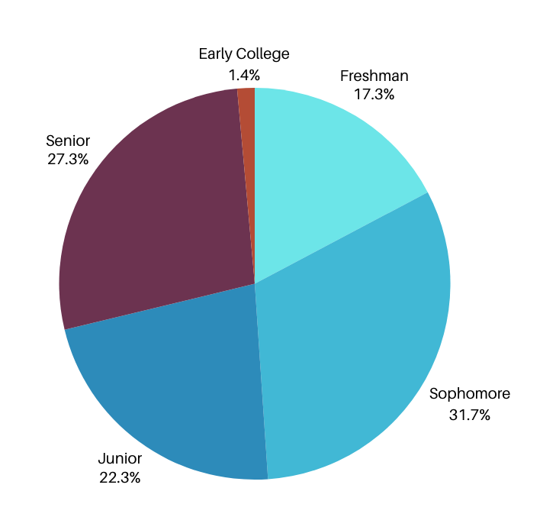
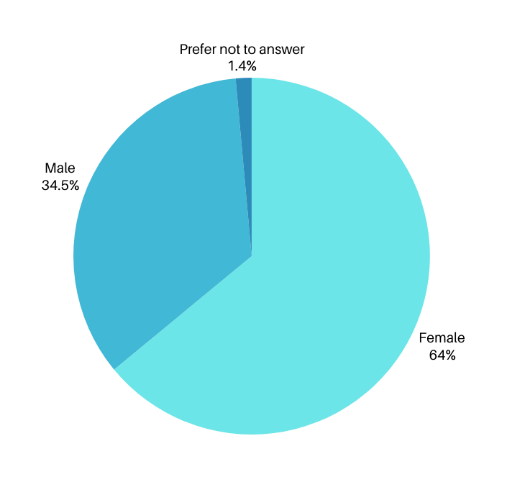
SURVEY RESPONDENT PROFILE
Respondents by Year
Respondents by Gender

Slide 10
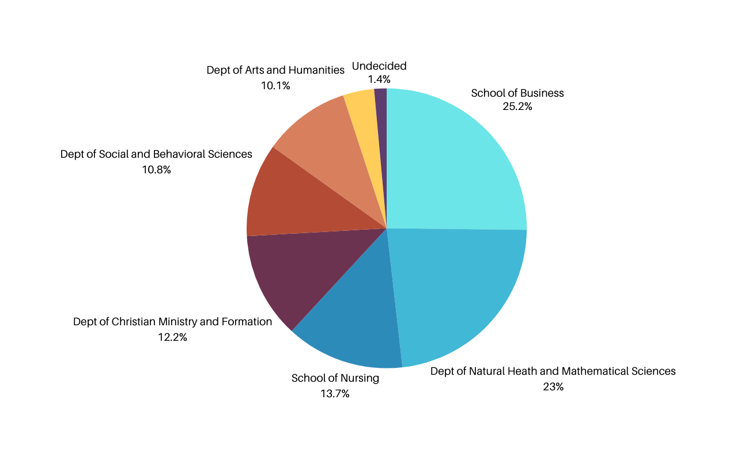
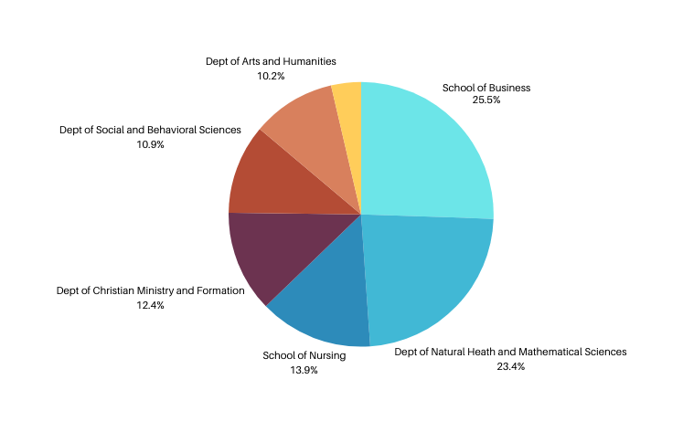
SURVEY RESPONDENTS
Sample Profile
Population Profile - Fall 2023
MNU’s Departmental Breakdown
Respondents by Department
Notes:
Key to a good survey is representativeness
By department, we are close to having a perfect representative match
Population Profile by Lisa Bouvier, Institiutional Research Analyst.
Based on last semster's student demographic.

Slide 11

Findings by Objective
Notes:
what you've waited for:
organized by objective, we tried to solve this!

Slide 12
Objective #1
Identify strengths, weaknesses, and student satisfaction
in the current advising system.

Slide 13
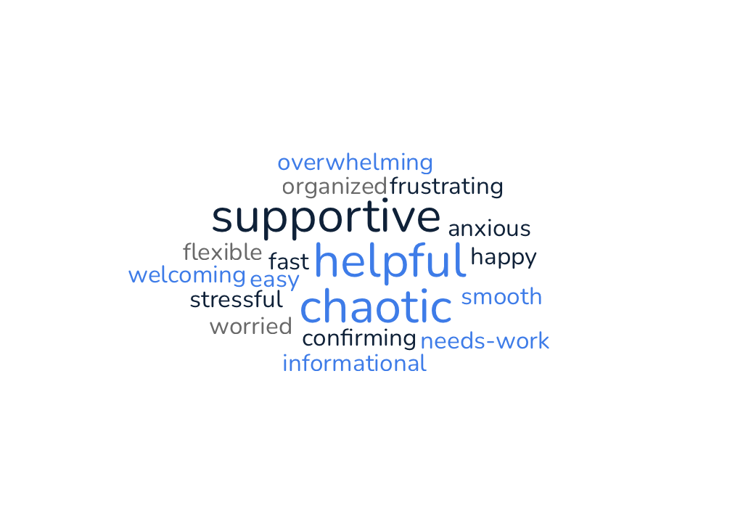
Focus Group Word Cloud
“What are some words that come to mind when thinking of your academic advising experience?”
Notes:
Explain top of mind awareness
Tell more stories

Slide 14
FOCUS GROUP FINDINGS
OBJECTIVE #1
1
2
3
4
PERSONAL RELATIONSHIPS STUDENTS VALUE ADVISORS WHO ENGAGE BEYOND ACADEMICS, DISCUSSING PERSONAL INTERESTS AND FUTURE PLANS. | DEGREE WORKS CHALLENGES Students often encounter issues with Degree Works such as catalog mismatches and outdated course requirements, leading to frustration during advising sessions. | ADVISOR COMMUNICATION AND TRUST CLEAR COMMUNICATION OF DEGREE REQUIREMENTS AND ACADEMIC PLANNING IS CRUCIAL. TRUST IN ADVISORS IS ESSENTIAL; POOR COMMUNICATION CAN LEAD TO DISSATISFACTION. | FACULTY ADVISOR PREFERENCE Students generally prefer faculty advisors for stronger personal connections and better academic guidance.
PERSONAL RELATIONSHIPS STUDENTS VALUE ADVISORS WHO ENGAGE BEYOND ACADEMICS, DISCUSSING PERSONAL INTERESTS AND FUTURE PLANS. | DEGREE WORKS CHALLENGES Students often encounter issues with Degree Works such as catalog mismatches and outdated course requirements, leading to frustration during advising sessions. | ADVISOR COMMUNICATION AND TRUST CLEAR COMMUNICATION OF DEGREE REQUIREMENTS AND ACADEMIC PLANNING IS CRUCIAL. TRUST IN ADVISORS IS ESSENTIAL; POOR COMMUNICATION CAN LEAD TO DISSATISFACTION. | FACULTY ADVISOR PREFERENCE Students generally prefer faculty advisors for stronger personal connections and better academic guidance.

Slide 15
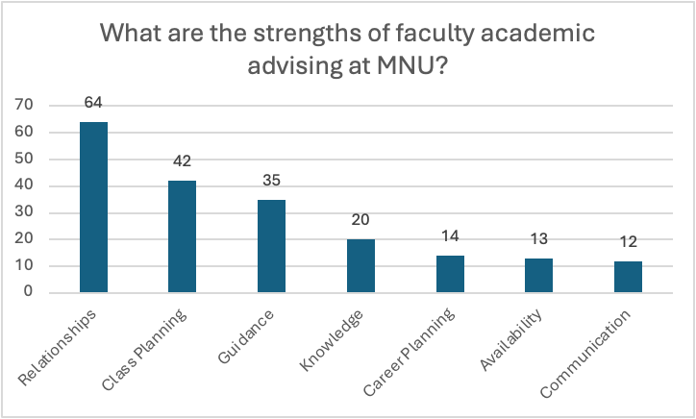
Objective 1: Survey Findings
Strengths
  Over half of respondents reported that they enjoyed or benefitted from the relationship they had with faculty.
  124 out of 125 students had positive things to say about their academic advising experience.
number of respondents
Open-ended, 125 respondents.
“They are more than faculty. They care about the reasons in which you’re taking the classes and how they’ll help you and your future goals while also caring for you and making it an easy process”.
Notes:
explain open-ended
detail top 3

Slide 16
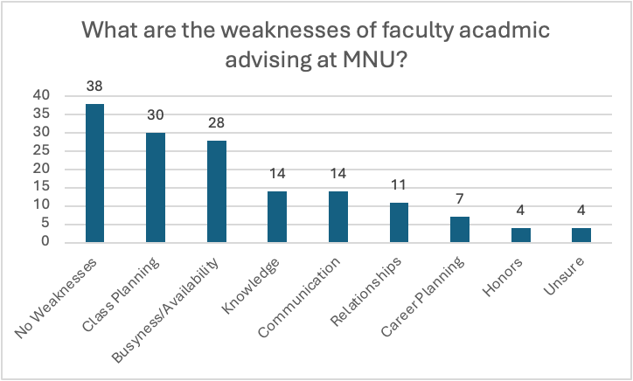
Objective 1: Survey Findings
Weaknesses
  33% respondents were satisfied with their academic advising experience and would not list a weakness.
  25.86% of MNU students listed Class Planning as a top weakness in their academic advising experience.
  24% of students reported they felt their advisors were overly busy or unavailable when needed.
number of respondents
Open-ended, 116 Respondents.
“...There are some things that I caught that my advisors didn't catch, and I believe that it was up to me to also be diligent about creating my schedule. This is not so much a weakness that the faculty of academic advising has, but a communication issue.”
Notes:
Over-explain, thematic analysis
focus on top 3
# of responses on left
explain no weaknesses- perfect

Slide 17
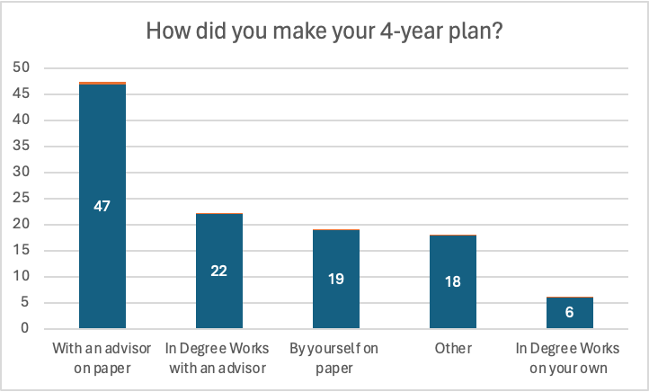
Objective 1: Survey Findings
4-year Planning
  42% of students make their plan with their advisor on paper.
  25% of students use DegreeWorks, and only 19% do so with their advisor.
  The majority of “other” responses (16%) create their own excell sheet.
number of respondents
Closed-ended, 112 responses.
Notes:
explain closed-ended
matrix
1-5 satisfaction, check scale

Slide 18
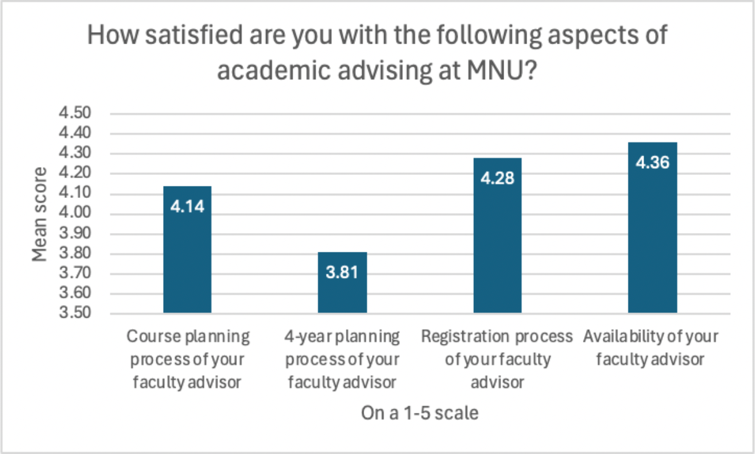
Objective 1: Survey Findings
Satisfaction
  The four year planning process with a faculty advisor scored as the least satisfied by students out of the four aspects of academic advising.
  The other three practices were scored at almost full satifaction by the students.
Closed-ended, 154 responses
Notes:
explain closed-ended
matrix
1-5 satisfaction, check scale
*check bulletpoints

Slide 19
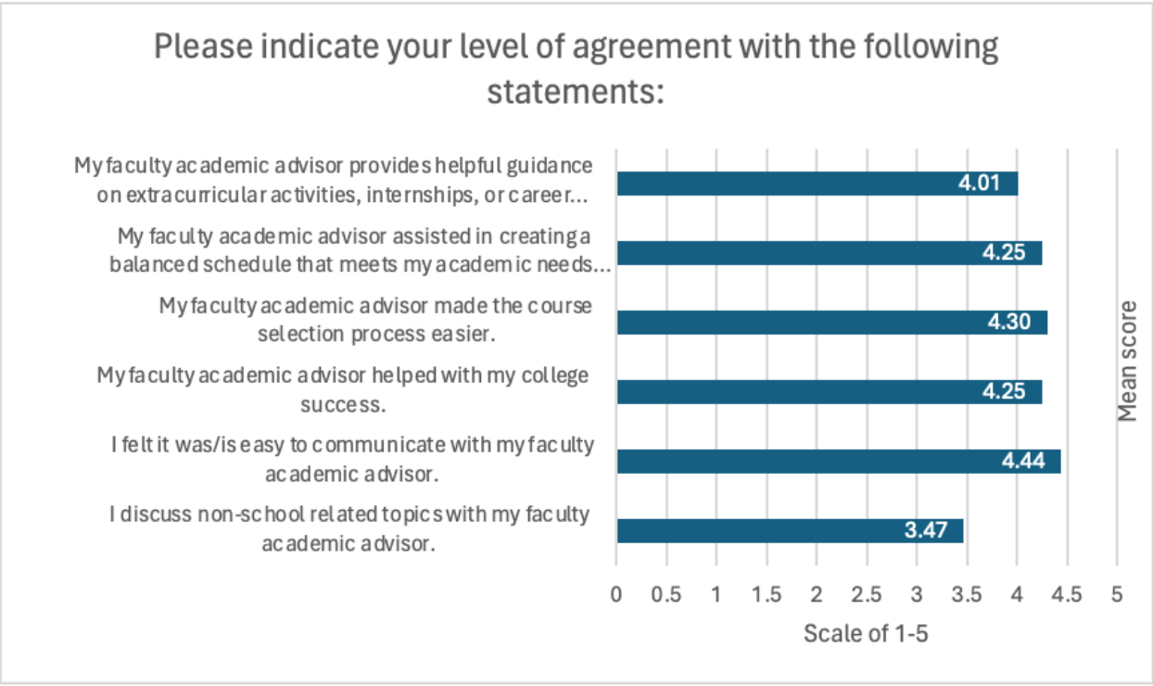
Objective 1: Survey Findings
Agreement
  Overall students felt it is easy to communicate with their academic advisor.
  Discussing non-school related topics is least important to students.
  A majority of students agree their advisor made the course selection process easier .
Likert scale of 1-5
Closed-ended, 151 responses
Notes:
Likert-scale, provided statements that they could rate on a scale of
disagree to agree

Slide 20
Objective 1 Recommendations
1.
Continue to foster relationships between faculty advisors and students.
2.
Update the catalog and DegreeWorks frequently.
3.
Provide training for faculty advisors or students to track catalog changes or plan changes.
Notes:
overall students are satisfied with current models. give kudos
enhance non-academic conversations
2 comes from focus group and some survey
not fully utilizing DegreeWorks
Recommendation 3: Implement a training process for Degree Works during departmental seminar - for example business seminar.
(add graph)
This may look like departmental seminar, or

Slide 21
Objective #2
Assess student perceptions and preferences regarding alternate advising models and practices.

Slide 22
ADVISING MODEL DEFINITIONS
FACULTY MODEL:
PROFESSIONAL MODEL:
MNU currently employs a faculty model for advising: professors will split up the work by department or major, and will advise students themselves either individually or in groups. Every student is assigned a faculty member from their major. Because faculty teaches the classes, they are very knowledgeable about the coursework and know the details of what the major entails, but not as much the graduation/scheduling issues.
A professional model of advising has full time staff designated just for academic advising- they would not be teachers, just advisors. As full-time advisors, they would be experts in scheduling and 4-year plans, but may not have knowledge about major- or career-specific questions.

Slide 23
FOCUS GROUP FINDINGS
OBJECTIVE 2
“
“
[There have b]een mistakes, he doesn't really know what's going on with me”
- Participant #8
Maybe if we have full time advisors there wouldn't be as many mistakes”
- Participant #9
PERCEPTION OF CURRENT ADVISING MODEL THE OPINION OF STUDENTS VARY BASED OFF THE INCONSTANT MODEL OF FACULTY ADVISING. “I GOT REALLY LUCKY BECAUSE MY ADVISOR STAYS ORGANIZED” - PARTICIPANT #7 | PROS OF CURRENT MODEL Faculty get to know students better and vice versa. Faculty have more knowledge of specific coursework that relates to the advisees field of study. | CONS OF CURRENT MODEL FACULTY ADVISORS ARE PERCEIVED AS EXTREMELY BUSY BY STUDENTS AND MAY NOT HAVE ENOUGH TIME TO GIVE NECESSARY INPUT TO ADVISEES. Non-homogeneous advising across departments | OTHER ADVISING MODELS While students generally prefer the faculty advising model, comments were made about the usefulness of full time advisors that could devote more time to specific goals for advisees.
PERCEPTION OF CURRENT ADVISING MODEL THE OPINION OF STUDENTS VARY BASED OFF THE INCONSTANT MODEL OF FACULTY ADVISING. “I GOT REALLY LUCKY BECAUSE MY ADVISOR STAYS ORGANIZED” - PARTICIPANT #7 | PROS OF CURRENT MODEL Faculty get to know students better and vice versa. Faculty have more knowledge of specific coursework that relates to the advisees field of study. | CONS OF CURRENT MODEL FACULTY ADVISORS ARE PERCEIVED AS EXTREMELY BUSY BY STUDENTS AND MAY NOT HAVE ENOUGH TIME TO GIVE NECESSARY INPUT TO ADVISEES. Non-homogeneous advising across departments | OTHER ADVISING MODELS While students generally prefer the faculty advising model, comments were made about the usefulness of full time advisors that could devote more time to specific goals for advisees.
Notes:
Relax
to assess professional model, had to compare

Slide 24
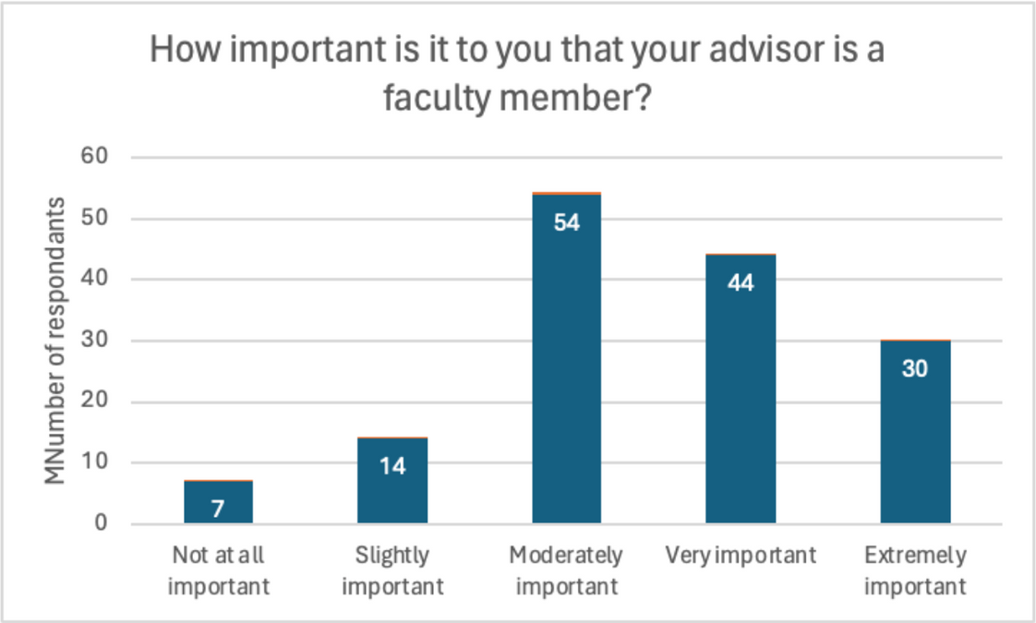
Objective 2: Survey Findings
  Majority of students agree faculty advising is only moderately necessary.
  128 out of 149 (86%) student respondents find having a faculty advisor to be important to some degree.
Closed-ended149 responses
Notes:
5-point important scale

Slide 25
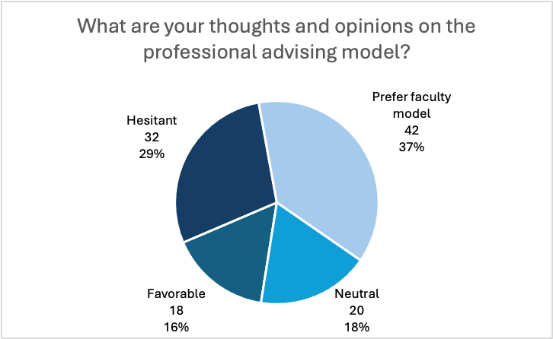
Objective 2: Survey Findings
Professional
  37% of students would prefer keeping a faculty advising model.
  Many students are open to the professional model, given certain stipulations.
  Students list issues such as time management, organization, class knowledge, networking, and availability as problems that would need to be improved if they were to enjoy the switch from faculty to professional.
Open-ended, 107 respondents.
Notes:
students were presented with the definition of professional advising as we showed you, then were asked thoughts and opinons,
thematic anlysis

Slide 26
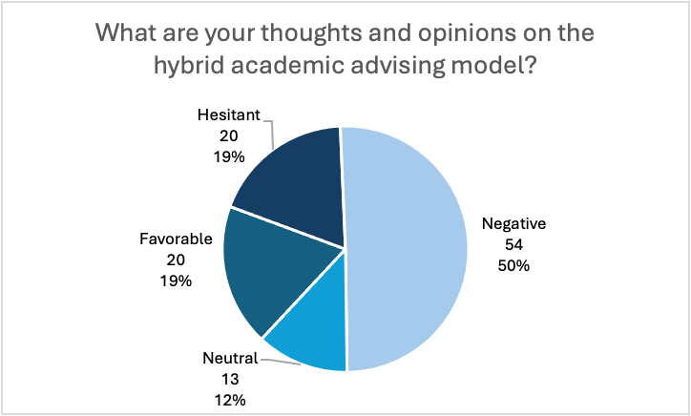
Objective 2: Survey Findings
Hybrid
  50% of students don’t see benefit to a hybrid model
  With only 19% favoring the hybrid model it doesn't seem ideal in the students’ mind.
  Students found it to be too chaotic.
Open-ended, 107 repondents.

Slide 27
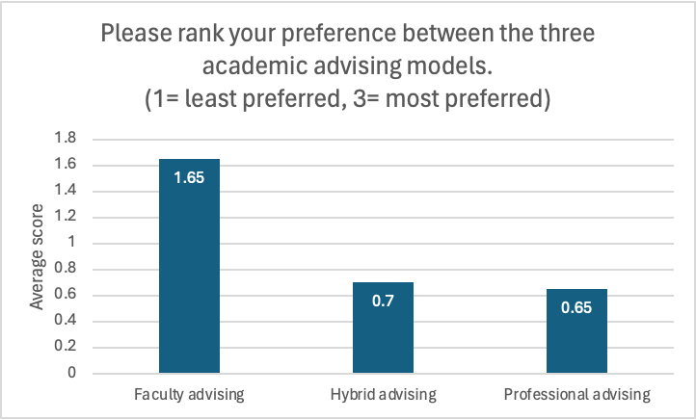
Objective 2: Survey Findings
Q25
Preference
  This scaled question used a 1-3 scale from least to most preferred.
  It was found that continuing to use faculty advising is what current traditional undergrad students prefer.
  The least popular advising model would be the professional model.
Closed-ended, 140 responses.

Slide 28
Objective 2 Recommendations
Continue utilizing the faculty advising model!
Notes:
Responsibility needs to be communicated- is it on students or on faculty?
find quote to back that up

Slide 29
Objective #3
Determine best practices for effective student
advising at other universities.

Slide 30

SECONDARY RESEARCH
Strengths Importance of personal relationships Positive advisor experience Faculty advisor preference | Weaknesses Meeting timing and stress Degree Works challenges Communication
Opportunities Improved advisor communication Proactive advising Enhanced training for advisors | Threats Student dissatisfaction Competitive landscape Technological Challenges
OBJECTIVE 3: FINDINGS
Compared to:
  Baker University
  Missouri State University
  BAU University
  Harvey Mudd College
  Grinnell College
  Colorado College
  Benedictine University
  Central Methodist University
Academic Advising – MidAmerica Nazarene University,
Notes:
come back- internal?

Slide 31
SECONDARY RESEARCH: MODELS
Objective 3: Findings
Traditional Academic Advising Model
Faculty Advising Model
Professional Advising Model
Hybrid Advising Model
This model involves one-on-one meetings between students and academic advisors, where advisors assist students in course selection, major exploration, and academic planning. These advisors typically work within specific academic departments or colleges.
Each faculty member is assigned a group of students whom they mentor and advise throughout their academic journey. This assigned advisor serves as the primary contact person for academic guidance and support.
Professionals with a career in advising take the role at the university offering complete focus to student success as well as direct knowledge in advising.
Some universities create collaborative advising networks involving faculty, academic advisors, career counselors, and student support services. These networks offer comprehensive and coordinated support to students during their academic journey.

Slide 32
Benefits Advisors expand students' options and understanding, guiding them toward contacts and opportunities aligned with their goals. | Certifications & Training Academic advisors require relevant degrees and must stay updated on trends, policies, and best practices for effective guidance. | Scheduling Options Universities offer online resources for contact information and office hours, with some providing walk-in opportunities for immediate assistance. | Environment Academic advising rooms should include private spaces for one-on-one consultations, desks or tables for comfortable discussions, and areas for group advising sessions or workshops with adequate lighting. | Peer Advising Peer advisors enhance support services by providing accessibility and demonstrating program importance. Selection involves formal processes with training to ensure adherence to institutional policies.
OBJECTIVE 3 FINDINGS: SECONDARY RESEARCH
5
4
3
2
1

Slide 33
  Promoting development advising as an ongoing process considering academic, career, and personal needs.
  Advising as teaching to develop critical thinking skills and set goals.
  Building meaningful relationships.
  Using assessment and technology to track student progress and leverage technology platforms.
  Encouraging professional development and training for advisors by NACADA.
Secondary
Research
5 Best Practices
National Academic Advising
Association. (n.d.)
Notes:
1- where students recognize advising is an ongoing process, and the advisor must consider academic, career, and personal needs.
2- where advisors help students develop critical thinking skills, set goals, and make informed decisions
4- This includes tracking student progress, utilizing data to identify trends, and leveraging technology platforms for scheduling and communication.
5- , including training, multicultural competence, and staying informed on policies and resources.

Slide 34


Secondary Research
Hybrid Model
Objective 3: Findings
Hybrid models in academic advising can be highly beneficial for students and advisors alike.
  Flexibility
  Personalization
  Efficiency
  Adaptability
  Improved Retention and Success
Hybrid advising (combining digital and in-person interactions) enhances student engagement, retention rates, and academic performance compared to traditional methods, offering flexibility and personalized experiences.
Notes:
consider hide?

Slide 35
Objective 3 Recommendations
1.
4.
7.
Comprehensive Advisor
Training
Early and Proactive
Meetings
Technology Integration
2.
5.
8.
Structured Advising
Processes
Comprehensive Advisor
Training
Clear Communication
and Transparency
3.
6.
9.
Personalized Holistic
Approach
Resource Accessibility
Continuous Feedback
Loop

Slide 36
Limitations
Notes:
any time you conduct research, there is imperfections...

Slide 37
Limitations
  We used a nonprobability sampling method called voluntary response sampling.
  High cancellation rate for focus group.
  Lack of crosstabulation data.
Notes:
wasn't conducted in a random manner, so can't project onto whole population
survey vs focus group
FG- had to recruit
due to time restraints,
raw data can all be calculated
demographic questions weren't included
research was positive-didn't find significance differences on basic crosstabs
planning to include additional information on final report.

Slide 38

RECOMMENDATIONS FOR FURTHER RESEARCH
HONORS PROGRAM MANY OF OUR FOCUS GROUP PARTICIPANTS DISCUSSED SOME FRUSTRATING ATTRIBUTES. | FACULTY OPINION IT WILL BE GOOD TO REEVALUATE THEIR PERCEPTIONS AND OPINIONS.
HONORS PROGRAM MANY OF OUR FOCUS GROUP PARTICIPANTS DISCUSSED SOME FRUSTRATING ATTRIBUTES. | FACULTY OPINION IT WILL BE GOOD TO REEVALUATE THEIR PERCEPTIONS AND OPINIONS.
Notes:
Honors program-
difficulty of communication between advisors
remove departmental development?

Slide 39
Questions?
Notes:
Answers the objectives here,
Final report will be here by the end of the week
every question is graphed,
focus group data/reponses

Slide 40


Slide 41

National Academic Advising Association. (n.d.).
Retrieved from https://nacada.ksu.edu/
ACADEMIC ADVISING – A CONCEPTUAL INTEGRATION OF ADVISING MODELS AND APPROACHES. Retrieved from https://iaeme.com/MasterAdmin/Journal_uploads/IJE/VOLUME_2_ISSUE_2/IJE_02_02_002.pdf
Harvey Mudd College. (n.d.). Academic Advisory System. Retrieved from https://www.hmc.edu/cis/services/academic-advisory-system/#:~:text=Academic%20Advisories%20are%20sent%20via,receives%20two%20or%20more%20advisories.
Grinnell College. (n.d.). Academic Advising. Retrieved from https://www.grinnell.edu/about/leadership/offices-services/academic-advising
Van Loon, R., & Jones, K. M. (Year). Higher Education Facility Planning and Design. Publisher XYZ
Smith, J. A. (Year). Designing effective advising spaces. Academic Advising Today, 42(3), 56-65. https://nacada.ksu.edu/Resources/Academic-Advising-Today.aspx
California State University San Marcos Academic Advising Center. (n.d.). Peer Advising. Retrieved from https://www.csusm.edu/academicadvising/peeradvising/rr.html
Colorado College. (n.d.). Advising Hub. Retrieved from https://www.coloradocollege.edu/other/advising-hub/
Author(s). (Year). Academic Advising as a Tool for Student Success and Educational Equity. Retrieved from https://www.advisingsuccessnetwork.org/wp-content/uploads/ASN_CaseStudies_Advising.pdf
Resource
Page

Slide 42


Slide 43




















Resource
Page
Use these design resource in your
Canva Presentation. Happy designing!
Don't forget to delete or hide this page before presenting.

Slide 44
Resource
Page
B | for blur | C | for confetti
D | for a drumroll | M | for mic drop
O | for bubbles | Q | for quiet
U | for unveil | 0-9 | Any number from 0-9 for a timer
Find the magic and fun in presenting with Canva Presentations.
Press the following keys while
on Present mode!
Delete or hide this page
before presenting.

